Slide 1

CS4157
Software Quality
Notes:
CS5707 Software Development Paradigms
John Dawson
CS5707 Software Development Paradigms
John Dawson
CS5707 Software Development Paradigms
John Dawson

Slide 2
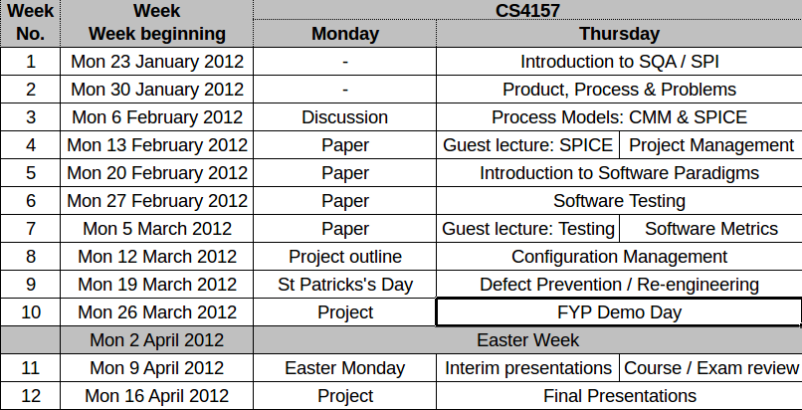
Course Schedule

Slide 3
Lecture Outline: Week 11 – 9th April
Exam overview
Course review
Notes:
CS5707 Software Development Paradigms
John Dawson
CS5707 Software Development Paradigms
John Dawson
CS5707 Software Development Paradigms
John Dawson

Slide 4
Exam Review
Date: Tuesday 1st May
Assessment: 50% of module
Structure: 2 questions, 1½ hours:
  First question: answer five out of seven short questions; 50 out of 80 marks
  Second question: answer one of two questions; 30 out of 80 marks

Slide 5
Resources
Lectures, guest lectures, slides and other material on web
Papers: assessable and others
Books: recommended and other
Assessment instruments

Slide 6
Books
Prime Texts
Ian Sommerville (2006) Software Engineering (update) (8th edition), Addison-Wesley
Roger S. Pressman and Roger Pressman (2004) Software Engineering: A Practitioner's Approach (6th edition), McGraw-Hill
Sami Zahran (1998) Software Process Improvement: Practical Guidelines for Business Success, Addison-Wesley Professional
Daniel Galin (2003) Software Quality Assurance: From Theory to Implementation, Addison-Wesley
Other Texts
Watts S. Humphrey (1989) Managing the Software Process, Addison Wesley
Notes:
CS5707 Software Development Paradigms
John Dawson
CS5707 Software Development Paradigms
John Dawson
CS5707 Software Development Paradigms
John Dawson

Slide 7
Key Concepts
Product and Process
Models, Maps and Frameworks
Assessment and Improvement
Processes / Key Process Areas
Testing and S/W Quality
Measurement and S/W Quality
Defect Prevention and S/W Quality
Iteration ...

Slide 8
Course Topics
Introduction, history, rationale
Process models: CMM, SPICE etc.
Selected key processes
  Software Testing and Metrics
  Configuration Management
  Defect Prevention

Slide 9
Product & Process
Key ideas:
To improve the quality of a (software) product, you have to improve the quality of the processes that produces it
Process improvement implies measurement
Measurement affects process
Measuring the quality of a software product is familiar; we do this by testing it (quantitatively)
Measuring the quality of a process is more difficult, this is an esential idea in this module
Notes:
CS5707 Software Development Paradigms
John Dawson
CS5707 Software Development Paradigms
John Dawson
CS5707 Software Development Paradigms
John Dawson

Slide 10
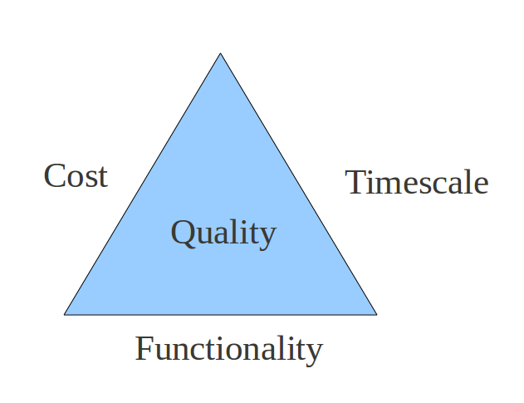
What is Software Quality
Notes:
CS5707 Software Development Paradigms
John Dawson
CS5707 Software Development Paradigms
John Dawson
CS5707 Software Development Paradigms
John Dawson

Slide 11
Software Quality Attributes
Reliability / Availability (3, 4 or 5 9's / MTBF)
Safety / Robustness
Efficiency / Performance
Learnability / Usability
Portability / Interoperability
Maintainabilty / Testability / Configurability
Reusability / Expandability / Survivability
Notes:
CS5707 Software Development Paradigms
John Dawson
CS5707 Software Development Paradigms
John Dawson
CS5707 Software Development Paradigms
John Dawson

Slide 12
The Immature Process
Unmanaged change
Failure to recognise that change is a constant
Agreeing to changes without re-planning
Failure to keep records
Implementation of changes minimally gradually degrades design integrity
Notes:
CS5707 Software Development Paradigms
John Dawson
CS5707 Software Development Paradigms
John Dawson
CS5707 Software Development Paradigms
John Dawson

Slide 13
Maps and Models
Reminder
“The map is not the territory”
Attributed to Alfred Korzybski , b. 1879
“All models are wrong,
but some are useful”
Attributed to George Box, b. 1919

Slide 14
A framework for Change Management
Willman (1996) introduces a five-point framework for process change implementation
Pressure for change
Leadership and vision
Capable people
Actionable first steps
Effective rewards
Argues that all 5 are necessary for success

Slide 15
The Mythical Man-Month
Identified the non-linear relationship between number of staff and productivity
Doubling the number of staff does not halve the development time
  Communication overhead: n(n-1)/2
Brooks Law: “Adding manpower to a late software project makes it later”
Evidence is that small, co-located teams work best; they know each other and can easily talk (but consider GSD)

Slide 16
No Silver Bullet: Difficulties of Essence
Complexity: Fundamental discontinuity with science, which has always sought, and found, underlying, simplifying principles; in contrast, Computer Systems have a very high number of states
Conformity: As a “recent” arrival, software systems must conform to pre-existing, arbitrarily complex, human systems (PPARS)
Changeability: can change, will change – concrete can't change
Invisibility: persists, despite plethora of graphical tools – large scale, multi-dimensional, partial views etc.

Slide 17
Course Topics
Introduction, history, rationale
Process models: CMM, SPICE etc.
Selected key processes
  Software Testing and Metrics
  Configuration Management
  Defect Prevention

Slide 18
Capability Maturity Model: Overview
One of the earlier process models
Like other significant models, it is under continuous development
History: CMM refined into multiple models, including SW-CMM (for software), now superseded by CMMI (integration)
CMM characteristics
      Staged, rather than continuous
      Assessment, not process improvement
      Top level is a 5-level capability measure
Notes:
CS5707 Software Development Paradigms
John Dawson
CS5707 Software Development Paradigms
John Dawson
CS5707 Software Development Paradigms
John Dawson

Slide 19
CMM: Key Process Areas (KPAs)
The 5 maturity levels represent only the highest level of the CMM structure
The main sub-structure is KPAs; different KPAs are defined at each maturity level
Level 1 specifies no KPAs
Level 2 KPAs are found in most SPI initiatives e.g. PM, CM, SQA etc.
Level 3, 4 & 5 process include increasingly closely managed process descriptions
Notes:
CS5707 Software Development Paradigms
John Dawson
CS5707 Software Development Paradigms
John Dawson
CS5707 Software Development Paradigms
John Dawson

Slide 20
ISO 15504 / SPICE: Concepts
3-fold purpose
  Capability determination (of suppliers)
  Process improvement
  Self-assessment
2 dimensional view
  Process: processes are categorised
  Process capability / maturity: measured
… a continuous model: multiple processes are separately assessed

Slide 21
ISO 15504 / SPICE: Process Attributes
9 Process Attributes
1.1 - Process performance
2.1 - Performance management
2.2 - Work product management
3.1 - Process definition & tailoring
3.2 - Process resource
4.1 - Process measurement
4.2 - Process control
5.1 - Process change
5.2 - Continuous improvement
Process attributes are incremental: achievement at any level implies achievement at lowel levels
Process attributes are generic i.e. apply to every process

Slide 22
ISO 15504 / SPICE: Recap
Basic concept is the Process
Processes are grouped into 5 Categories
Every process is measured under 9 incremental Process Attributes
Each process measurement is assessed on a 4-point scale: Not / Partially / Largely / Fully
A process attribute rating can be expressed as a overall level of Process Capability
Aggregation is commonly used

Slide 23
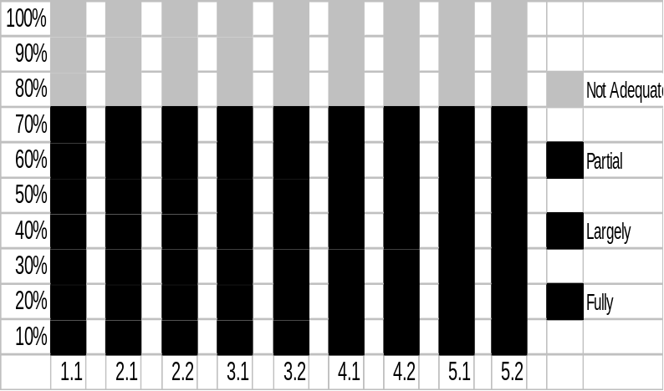
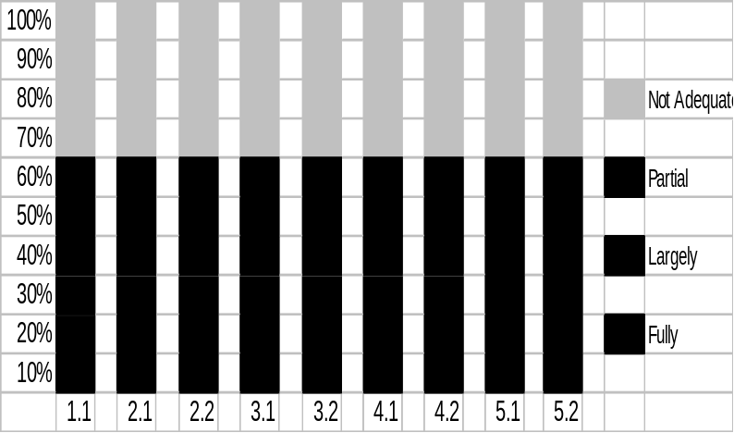
SPICE / ISO 15504 – 15
Sample SPICE assessment & target comparison
Identification of “gaps”
Target has a steady progression of capability over process attributes
Assessment is more uneven
Suggests both areas that should be improved and areas from which some resource could be drawn
Actions should:
  Be as simple as possible
  Identify risks before action
  Makes smallest changes with maximum business value first
  Be consistent with available resource

Slide 24
Course Topics
Introduction, history, rationale
Process models: CMM, SPICE etc.
Selected key processes
  Software Testing and Metrics
  Configuration Management
  Defect Prevention

Slide 25
Software Testing: Terms
Test: the process of executing a program with the intention of finding bugs
Bug: preferred term?
Defect: more generic, applies to other artefacts
Validation: are we building the right product?
Verification: are we building the product right?
Debugging: Investigating / fixing bugs

Slide 26
Software Testing: Stages
Unit
Integration
Load / Performance / Test
System
Acceptance
Regression
The choice of appropriate testing stages depends on the type of software

Slide 27
Software Testing Techniques: 2a
In practice, there are nearly always too many cases for exhaustive testing and we use the notion of equivalence classes, more or less formally; a simple example:
The user enters a number between 1 and 12
We might take the three cases: <1, >12 and between 1 & 12 only i.e. we consider entering (say) 20 is equivalent to entering every (possible) number greater than 12
By this means, the number of necessary tests can be significantly reduced i.e. the non testable becomes testable

Slide 28
Software Testing Techniques: 2b
We might also consider the related topic of Boundary Value Testing
If this case, we would include entering 0, 1 & 2; also 11,12 & 13
Extending the idea slightly, we might check 5 & 6, also negative numbers and very large numbers

Slide 29
Software Testing: Myers' Axioms
A good test case is one that has a high probability of detecting a previously undiscovered defect, not one that shows that the program works correctly
One of the most difficult problems in testing is knowing when to stop
It is impossible to test your own program
A necessary part of every test case is a description of the expected output
Avoid non-reproducible or on-the-fly testing
Write test cases for invalid as well as valid input conditions
Thoroughly inspect the results of each test
As the number of detected defects in a piece of software increases, the probability of the existence of more undetected defects also increases
Assign your best programmers to testing
Ensure that testability is a key objective in your software design
The design of a system should be such that each module is integrated into the system only once
Never alter the program to make testing easier (unless it is a permanent change)
Testing, like almost every other activity, must start with objectives

Slide 30
What are software metrics
An attempt to apply quantitative methods to measurement of (software) process or product quality
A measurement of the degree to which a process or product possesses a particular attribute
Notes:
CS5707 Software Development Paradigms
John Dawson
CS5707 Software Development Paradigms
John Dawson
CS5707 Software Development Paradigms
John Dawson
CS5707 Software Development Paradigms
John Dawson

Slide 31
Software Metrics Taxonomy
Process Metrics
Quality: Bug density, severity, removal - effectiveness
Timetable: Achievement of milestones
Productivity: KLOC, function points, documents & reuse
Product Metrics
Dynamic: Excution time, response time, failures
Static: Fan-in / Fan-out (cohesion / coupling), module size, complexity measures, length of identifiers, nesting, Fog index – documents
Notes:
CS5707 Software Development Paradigms
John Dawson
CS5707 Software Development Paradigms
John Dawson
CS5707 Software Development Paradigms
John Dawson
CS5707 Software Development Paradigms
John Dawson

Slide 32
Course Topics
Introduction, history, rationale
Process models: CMM, SPICE etc.
Selected key processes
  Software Testing and Metrics
  Configuration Management
  Defect Prevention

Slide 33
Why Configuration Management
Classic sympoms of lack of or insufficient CM
Uncertainty about what changes have been made
Uncertainty about what changes have been delivered – to test or customers
Lost changes & uncontrolled overwrite
Fixed bugs mysteriously becoming unfixed
Divergent versions of software
High levels of stress!
Notes:
CS5707 Software Development Paradigms
John Dawson
CS5707 Software Development Paradigms
John Dawson
CS5707 Software Development Paradigms
John Dawson

Slide 34
Configuration Management Basics
CM key requirements:
Maintenance of system integrity
Identification of the configuration
Control of change
Offering tracebility
Notes:
CS5707 Software Development Paradigms
John Dawson
CS5707 Software Development Paradigms
John Dawson
CS5707 Software Development Paradigms
John Dawson

Slide 35
Configuration Management Layers
Concerned with the control of:
CM is the top layer: entire software product
Change management: control of a single identifiable change
Version control: an individual file: program, module, software artefact
Notes:
CS5707 Software Development Paradigms
John Dawson
CS5707 Software Development Paradigms
John Dawson
CS5707 Software Development Paradigms
John Dawson

Slide 36
Release Management Basics
RM is the identification and control of the entire software product
RM is particularly critical when there are multiple users of a software product – who may well be using different releases
RM controls the dependencies between different programs (and various other software objects) that comprise the release
This is achieved by identification of each version of each program that comprises the release
Notes:
CS5707 Software Development Paradigms
John Dawson
CS5707 Software Development Paradigms
John Dawson
CS5707 Software Development Paradigms
John Dawson

Slide 37
Build Management Basics
The build is the process of converting source code into executable programs; the purpose of CM is ultimately to control the quality of the executable, hence this requires control of the build as much as of the source
The first, essential, step is to write (or evolve) a build script
Typically, the build will be run for a specific release, and perhaps (regularly) just the latest (checked-in) version of all programs
There may also be control of the compiler / linker / interpreter
Notes:
CS5707 Software Development Paradigms
John Dawson
CS5707 Software Development Paradigms
John Dawson
CS5707 Software Development Paradigms
John Dawson

Slide 38
Course Topics
Introduction, history, rationale
Process models: CMM, SPICE etc.
Selected key processes
  Software Testing and Metrics
  Configuration Management
  Defect Prevention

Slide 39
What is Defect Prevention?
Types of Defect Prevention (DP)
DP as bug management: concen-trate on finding, logging & fixing
DP as a driver for change: analyse defects ⇨ improve process
DP as process / techniques / tools for preventing problems
Notes:
CS5707 Software Development Paradigms
John Dawson
CS5707 Software Development Paradigms
John Dawson
CS5707 Software Development Paradigms
John Dawson

Slide 40
Why Defect Prevention?
“Prevention is better than cure”
Cost of defects rises later in the SDLC, hence the development of:
Iterative SPI models: Ideal, RUP etc.
Agile / XP / Scrum etc
In essense: Iteration
Notes:
CS5707 Software Development Paradigms
John Dawson
CS5707 Software Development Paradigms
John Dawson
CS5707 Software Development Paradigms
John Dawson

Slide 41
Defensive Programming
Coding Standards
Static Analysis
Software Inspections
Formal Methods
Examples
Notes:
CS5707 Software Development Paradigms
John Dawson
CS5707 Software Development Paradigms
John Dawson
CS5707 Software Development Paradigms
John Dawson

Slide 42
Software Transformation: Taxonomy
Re-engineering – legacy systems
Reverse engineering – no documents
Refactoring – add / recover quality
Re-writing – if all else fails ...
Notes:
CS5707 Software Development Paradigms
John Dawson
CS5707 Software Development Paradigms
John Dawson
CS5707 Software Development Paradigms
John Dawson

